Slide 1
UI!
AKA User Interface AKA Buttons and text

Slide 2
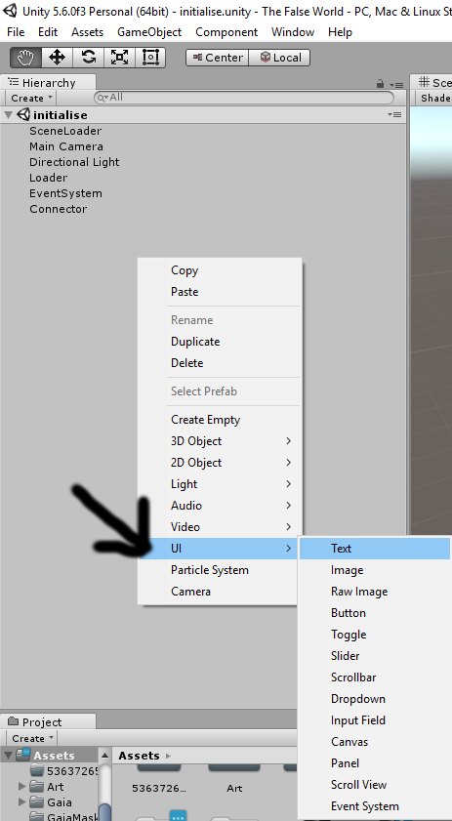
What are first steps?
1.) Right click.
2.) Navigate to UI.
3.) Navigate to the UI piece you want.

Slide 3
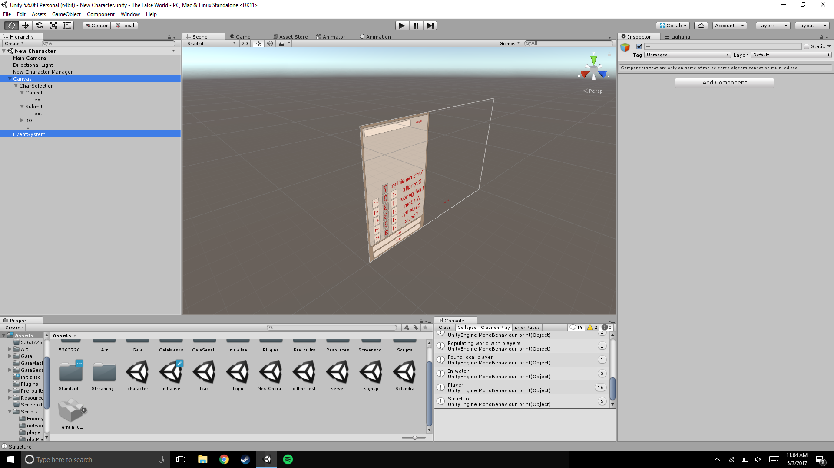
DON’T FREAK OUT
You may notice that three objects were created, instead of one
WHY IS THIS?
One object is the one you wanted to create.
One object is called “Canvas”, and is a parent for all UI.
One object is called “EventSystem”, and handles any
UI interactions, such as buttons.
For the most part, ignore
Canvas and EventSystem

Slide 4
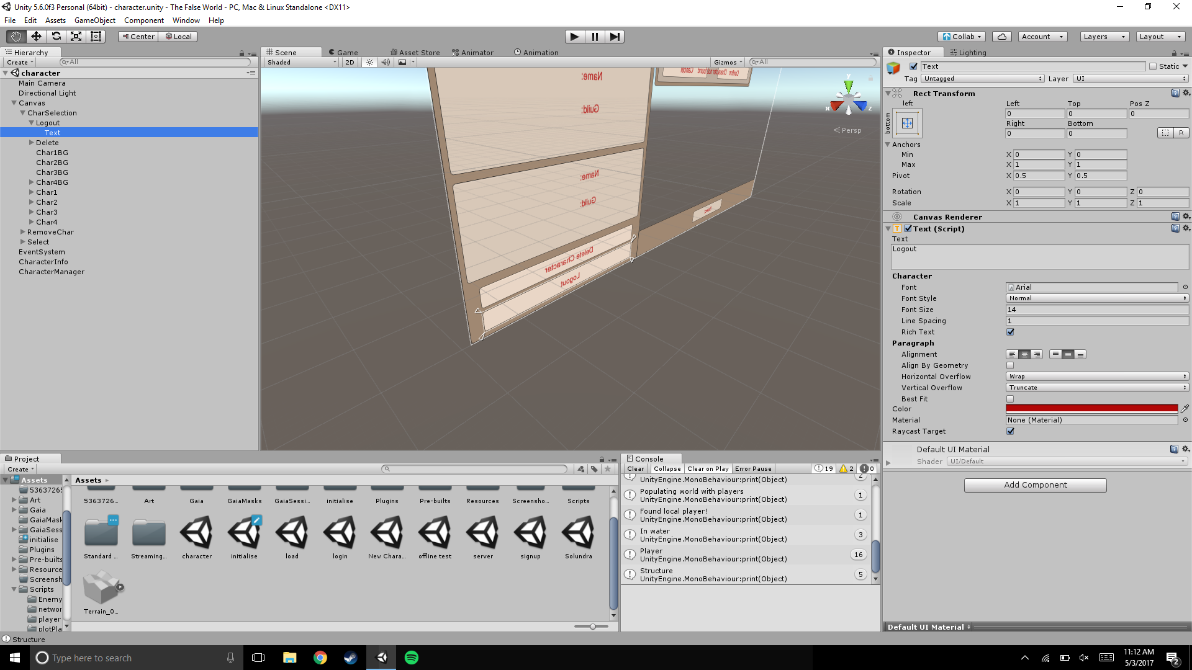
Text
Right click and create text.
Navigate to the object
Under the inspector, you’ll notice a
new component, called “Text(Script)”
The top variable, “Text”, is what the client sees.
You edit many variables of the text component.
Set Horizontal Overflow and Vertical Overflow
to “Overflow”

Slide 5
Preparing code for buttons
When you want to use a button, you need to prepare your code to do something when the button is pressed.
Create a new method, and call it whatever you want.
Make sure to declare it as public
EX: public void genericMethodName()
This is the method we’ll use when the button is pressed.

Slide 6
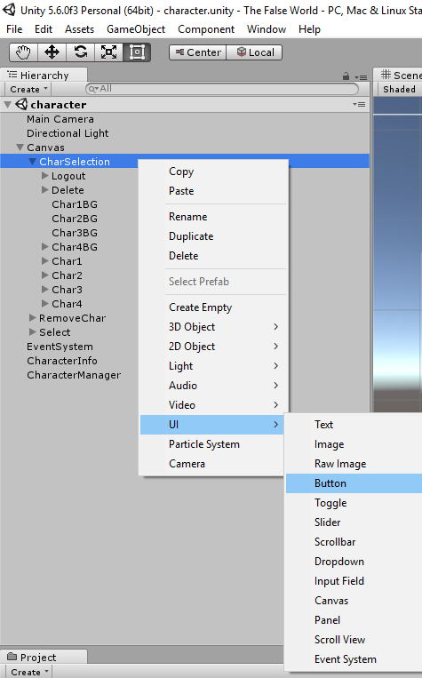
Actually creating the button.
Right click and create a button
Navigate to the object
Under the inspector, you’ll notice a
new component, called “Button(Script)”
The child object, “Text”, is what the client sees.
You edit many variables of the text component
in the child object.

Slide 7
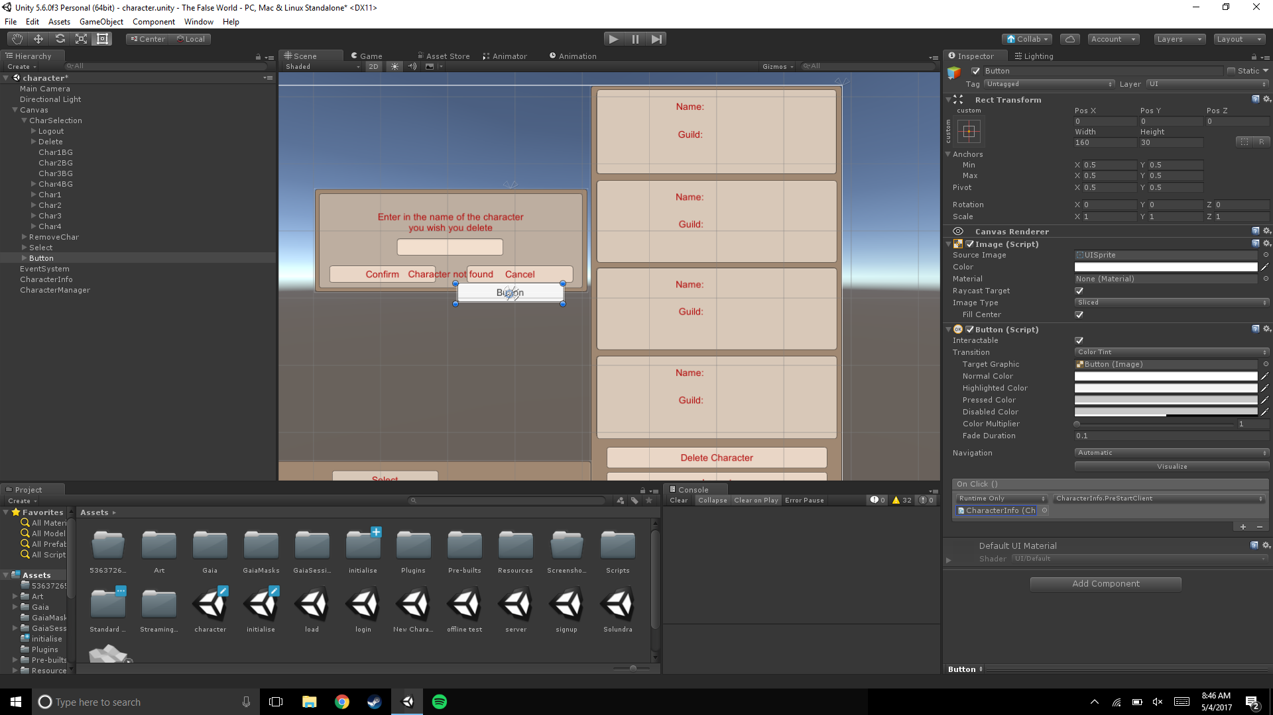

Making the button do what you want
Find the On Click() window
under the Button component
Click the plus button in the bottom right.
Drag the Game Object that contains
the script into the “None(Object)” box.
Find the “No Function” dropdown box,
and find your scripts name. Then, look
for your public method.

